Slide 1
Graphs and Visuals
SSI II
January 15, 2018

Slide 2
Previously…
Types of variables

Slide 3
Essential Questions
How should we decide what type of graph to use and what information to present?
What makes one graph better than another?

Slide 4
Representing Qualitative Data

Slide 5
Frequency Tables
Used for Categorical variables
Describes the distribution of the data and presents the raw frequencies (numbers in each category) and/or percentages for each of the variable’s values
What is another name for the percentage?

Slide 6
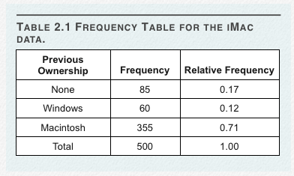
Previous Computer Ownership
Notes:
Source: Lane, Ch 2

Slide 7
Make a Frequency Table
Which type of computer do you prefer?
Value | Frequency | Percentage
Mac
PC
TOTAL

Slide 8
Frequency Tables
Values | Frequency | Percentage
Newspapers | 446
Internet | 243
TV | 916
Radio | 131
Family, Friends | 71
TOTAL | 1817 | 100%
Notes:
Source of News (2005 General Social Survey)

Slide 9
Frequency Tables
Values | Frequency | Percentage
Newspapers | 446 | 24.5%
Internet | 243 | 13.4%
TV | 916 | 50.4%
Radio | 131 | 7.2%
Family, Friends | 71 | 3.9%
TOTAL | 1817 | 100%
Notes:
Source of News (2005 General Social Survey)

Slide 10
Frequency Tables
Value | Frequency | Percentage
Extremely liberal | 70 | 4.3%
Liberal | 230 | 14.1%
Slightly liberal |  | 11.6%
Moderate; middle of the road |  | 31.6%
Slightly conservative |  | 14.6%
Conservative |  | 19.1%
Extremely conservative |  | 4.6%
Total | 1626 | 4.6%
Notes:
Liberal-conservative self-placement (2008 ANES)

Slide 11
Frequency Tables
Value | Frequency | Percentage
Extremely liberal | 70 | 4.3%
Liberal | 230 | 14.1%
Slightly liberal | 188 | 11.6%
Moderate; middle of the road | 514 | 31.6%
Slightly conservative | 238 | 14.6%
Conservative | 311 | 19.1%
Extremely conservative | 75 | 4.6%
Total | 1626 | 4.6%
Notes:
Liberal-conservative self-placement (2008 ANES)

Slide 12
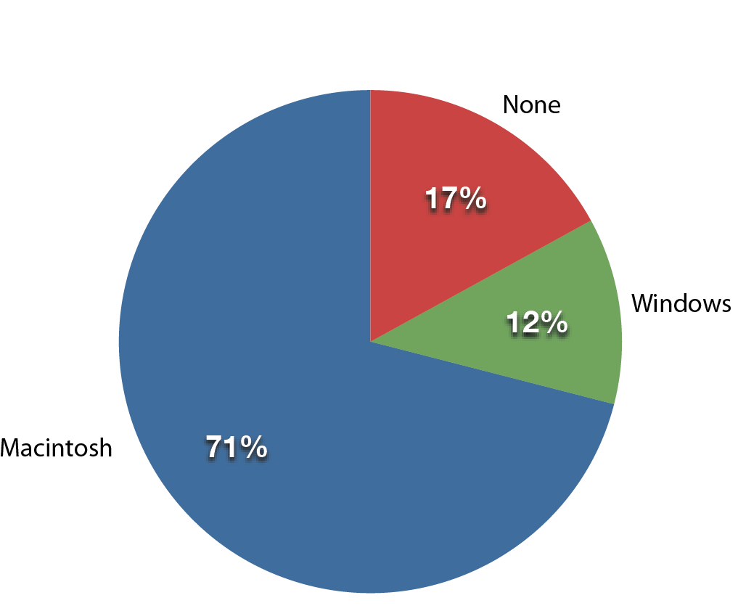
Pie Charts (?)
Each slice is proportional to the percentage of choices in the category.
Notes:
Source: Lane, Ch 2

Slide 13
Problems with Pie Charts
Not recommended when:
There are many categories
There is a small N
Comparing survey instruments/experimental outcomes
Most of the time?
“The only worse design than a pie chart is several of them.” ~Edward Tufte

Slide 14
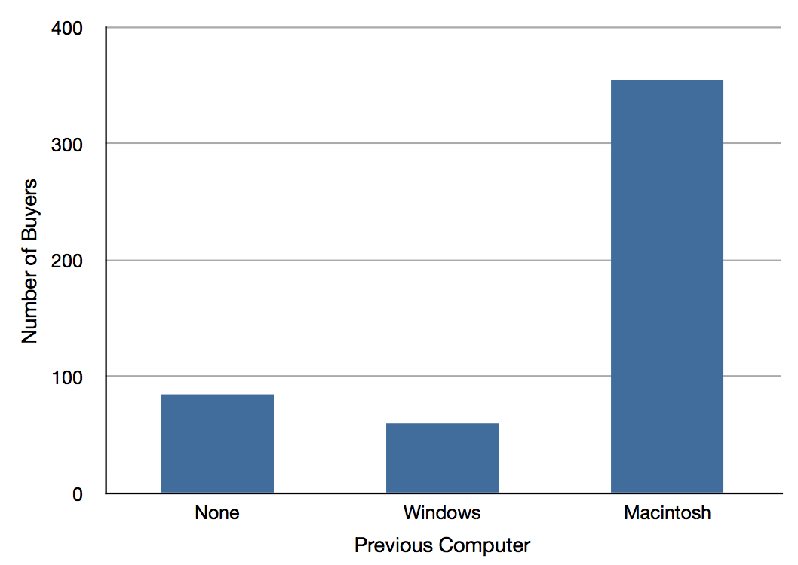
Bar Graphs/Charts
Notes:
Source: Lane, Ch 2

Slide 15
Bar Graphs/Charts
Used for categorical and ordinal variables

Slide 16
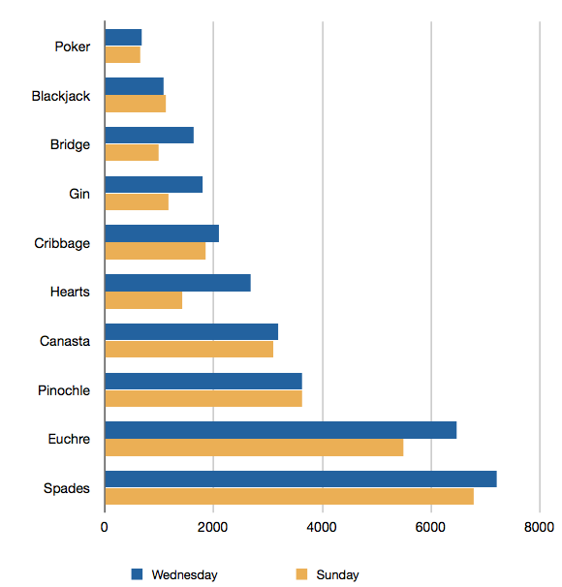
Why have two sets of bars?

Slide 17
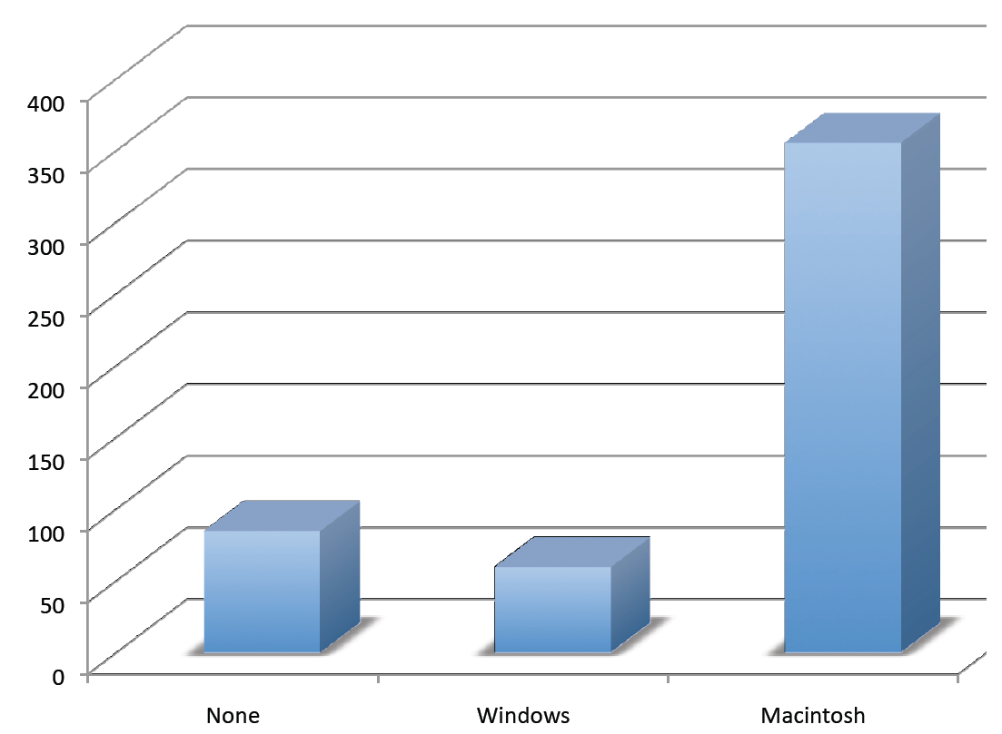
Avoid Getting Fancy

Slide 18
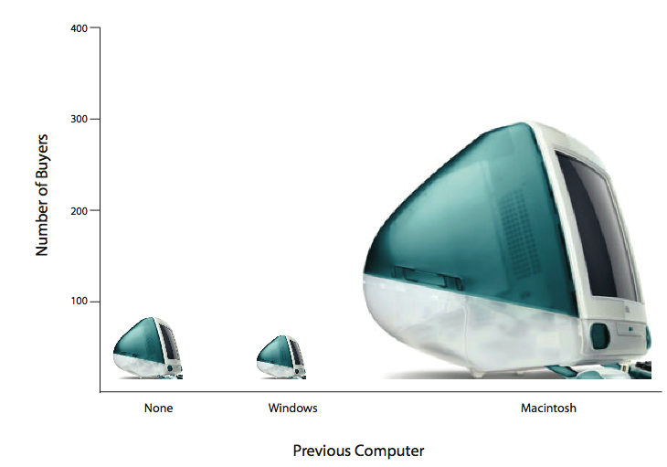
The Lie Factor
Notes:
Source: Lane Ch 2
Ratio of size of the effect in the graph: size of the effect in the data
Here, it is greater than 8, but Tufte argues only .95-1.05 is acceptable distortion

Slide 19
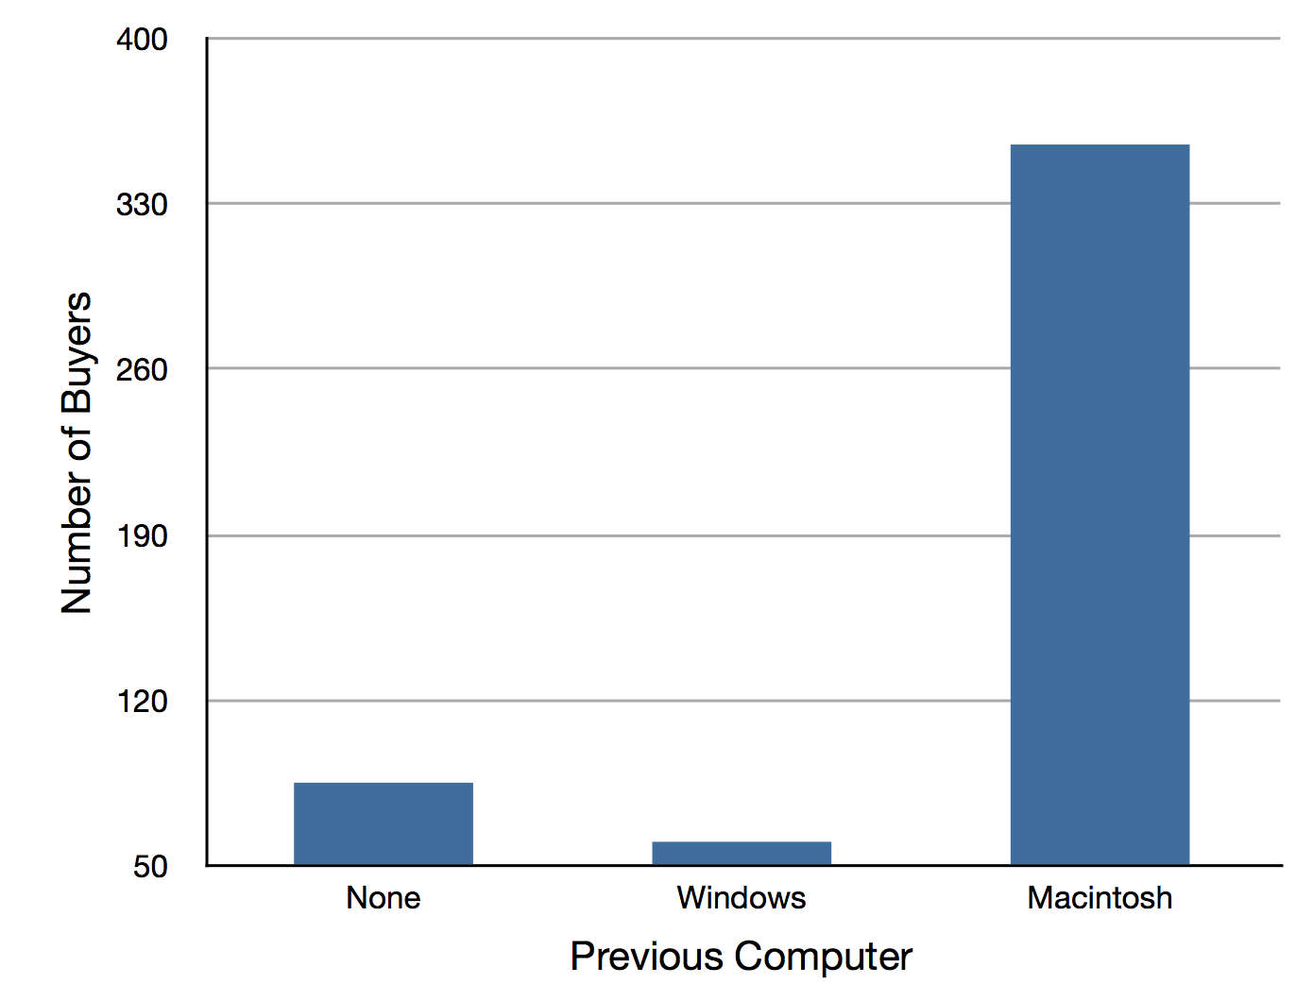
Misleading Baselines
Notes:
Source: Lane Ch 2

Slide 20
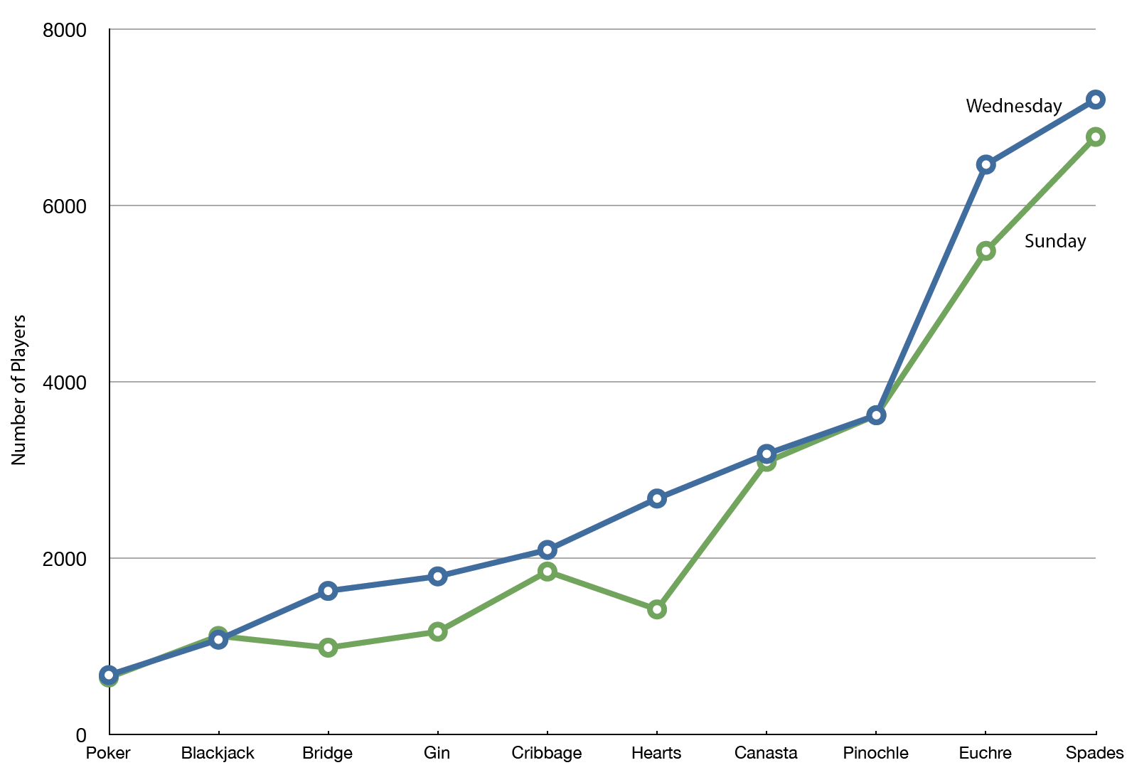
Inappropriate Use of Line Graphs
Notes:
Source: Lane, Ch 2

Slide 21
A Sampling of Business Insider’s 27 Worst Charts
What is wrong with each of these?

Slide 22
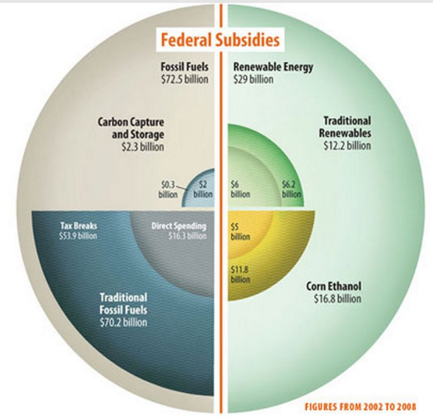
Notes:
Source: Hickey, Walter. “The 27 Worst charts of All Time.” Business Insider. June 26, 2013. http://www.businessinsider.com/the-27-worst-charts-of-all-time-2013-6

Slide 23
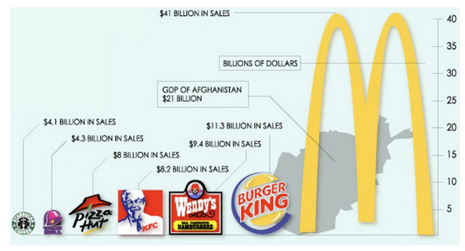

Slide 24
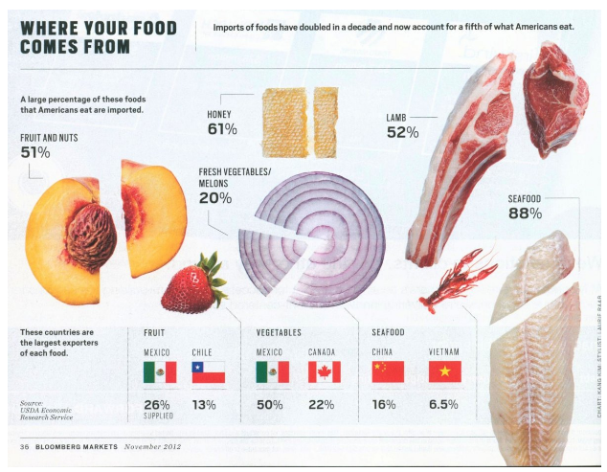

Slide 25
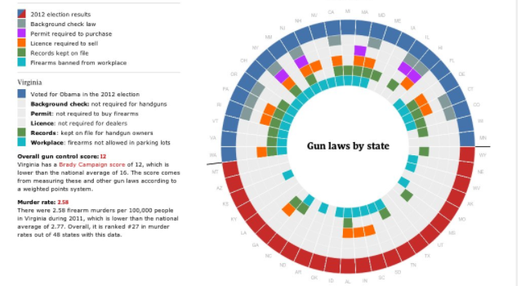
Part 1…

Slide 26
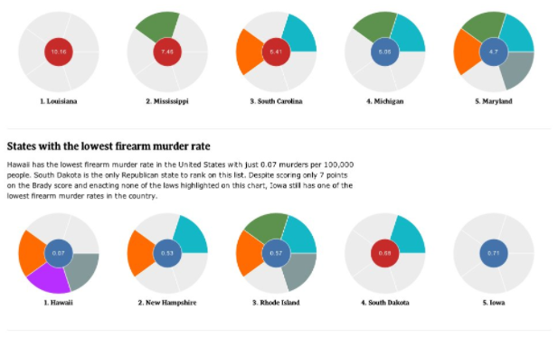
Part 2

Slide 27
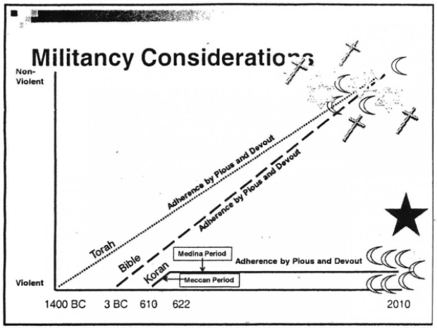
The content is obviously awful, but so is the graphing of it…

Slide 28
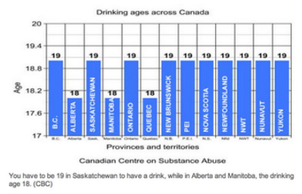

Slide 29
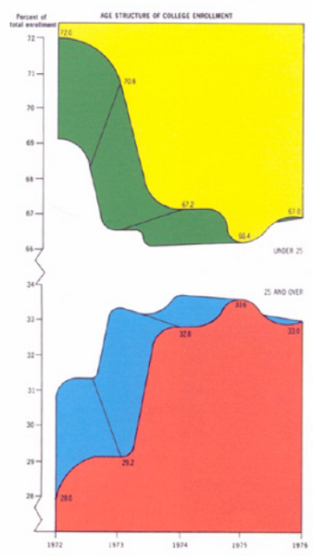
Tufte called this the worst chart, ever

Slide 30
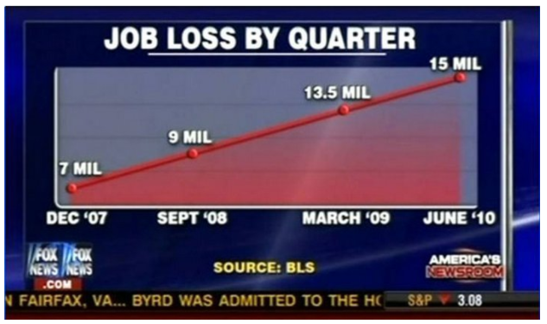

Slide 31
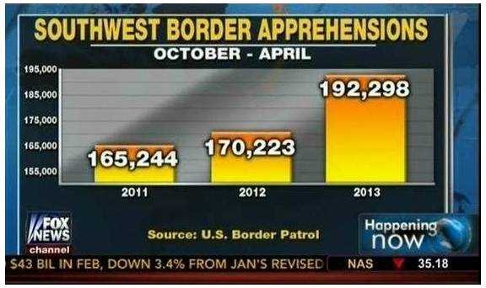
Notes:
Note the ‘October-April’ bit at the top: what do you think that means?
Also, apprehensions were significantly down from 2008

Slide 32
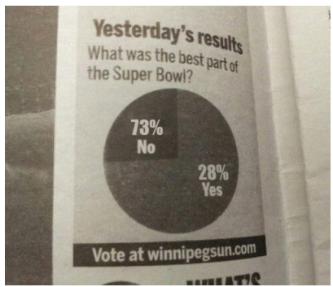

Slide 33
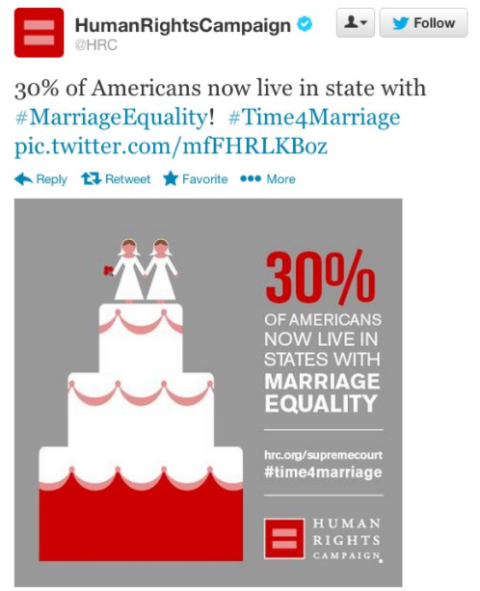

Slide 34
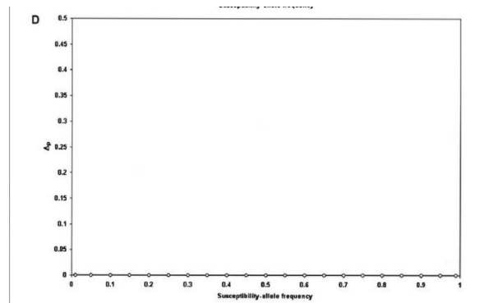

Slide 35
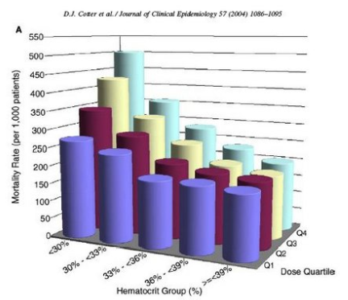

Slide 36
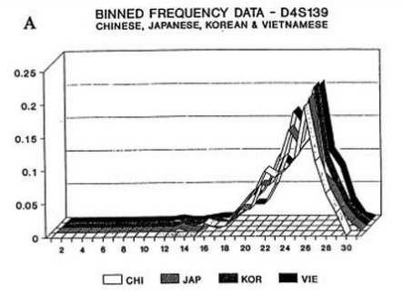

Slide 37
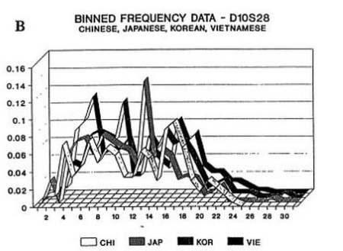

Slide 38
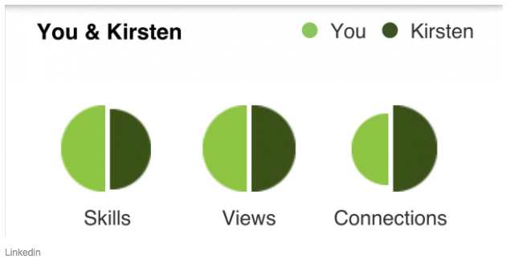

Slide 39
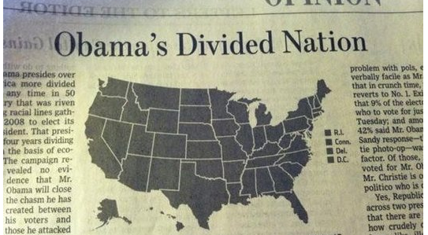

Slide 40
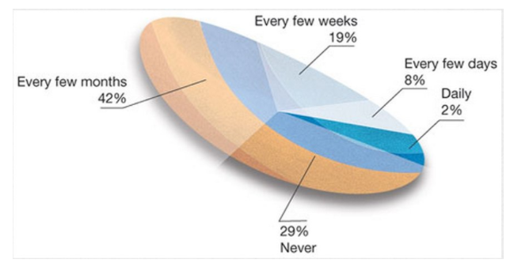

Slide 41
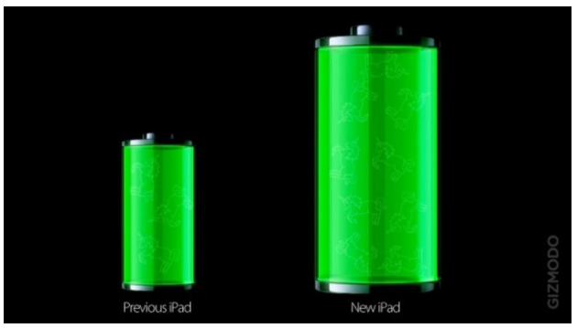

Slide 42
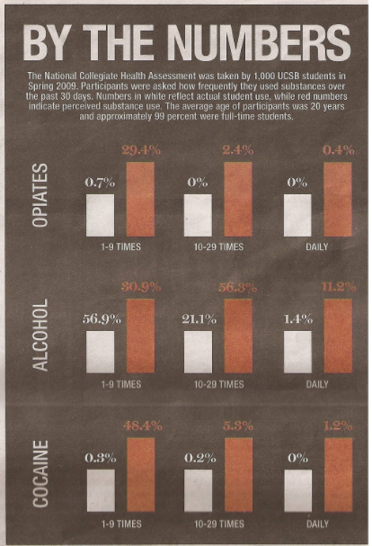

Slide 43
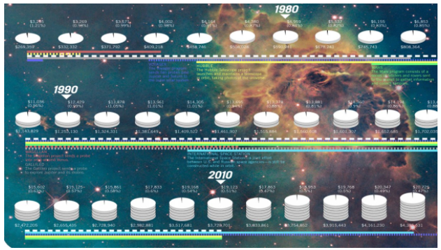
Irony of ironies… The source for this is “Good Infographics”

Slide 44
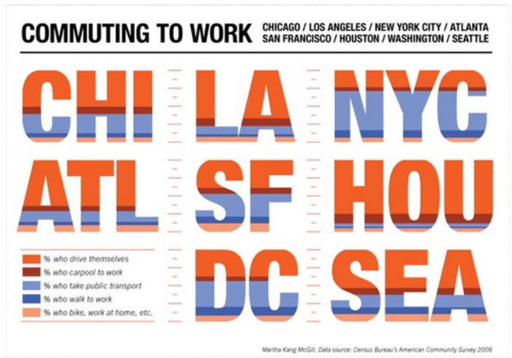

Slide 45
Contributed by a former student

Slide 46
Quantitative Data

Slide 47
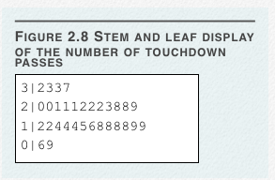
Stem-and-Leaf Display
Notes:
Source: Lane, Ch 2

Slide 48
Make Your Own for 2016
Team | TD Passes |  | Team | TD Passes
Green Bay | 40 |  | Jacksonville | 24
Atlanta | 38 |  | Seattle | 23
New Orleans | 38 |  | San Francisco | 21
Pittsburgh | 33 |  | Carolina | 21
San Diego | 33 |  | Denver | 20
Indianapolis | 32 |  | Minnesota | 20
New England | 32 |  | Baltimore | 20
Tennessee | 29 |  | Chicago | 19
Oakland | 29 |  | Kansas City | 19
Tampa Bay | 29 |  | Cincinnati | 18
Arizona | 28 |  | Buffalo | 17
Miami | 27 |  | NY Jets | 16
NY Giants | 26 |  | Philadelphia | 16
Dallas | 25 |  | Cleveland | 15
Washington | 25 |  | Houston | 15
Detroit | 24 |  | Los Angeles | 14
Notes:
Source: ESPN

Slide 49
Stem-and-Leaf Display
The Number of Touchdown Passes, 2016
4 | 0
3 | 223388
2 | 0001134455678999
1 | 4556678899

Slide 50
Comparing 2000 to 2016
NFL Touchdown Passes, 2000 and 2016
| 4 | 0
7332 | 3 | 223388
988322211100 | 2 | 0001134455678999
9988886544422 | 1 | 4556678899
96 | 0

Slide 51
Histograms
Continuous data
Good for displaying the shape of the distribution
Good when you have a large N
Y-axis can be frequency or percent

Slide 52
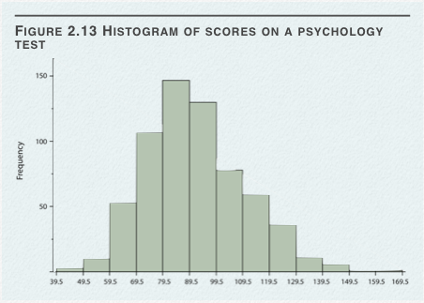
Histogram
Notes:
Source: Lane, Ch 2

Slide 53
Bin Width/Class Interval
Choose consistent widths/intervals
How many intervals is usually a judgment call
Rule of thumb: What is the fewest number you can have without losing the shape of the data?
Start with 10-15 and experiment

Slide 54
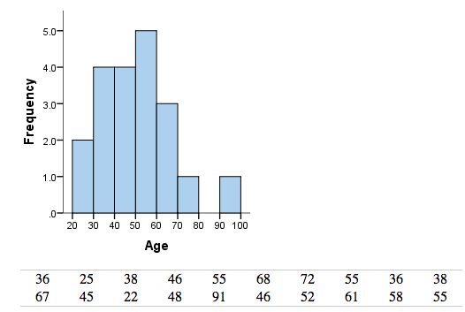
Reasonable Bin Widths
Notes:
Source: https://statistics.laerd.com/statistical-guides/understanding-histograms.php

Slide 55
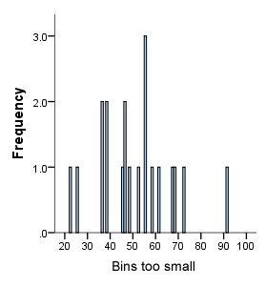
Bins Too Small
Notes:
Source: https://statistics.laerd.com/statistical-guides/understanding-histograms.php

Slide 56
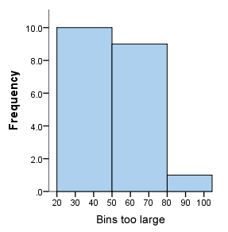
Bins Too Large
Notes:
Source: https://statistics.laerd.com/statistical-guides/understanding-histograms.php

Slide 57
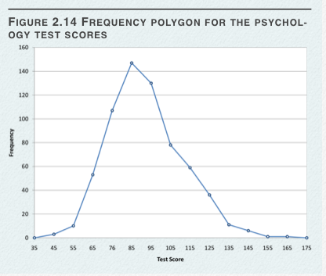
Frequency Polygon
Notes:
Source: Lane, Ch 2

Slide 58
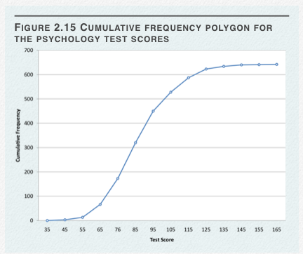
Cumulative Frequency Polygons
Notes:
Source: Lane, Ch 2

Slide 59
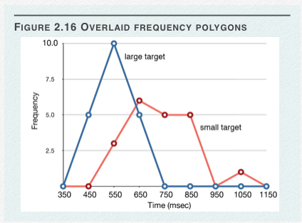
Overlaid Frequency Polygons
Notes:
Source: Lane, Ch 2

Slide 60
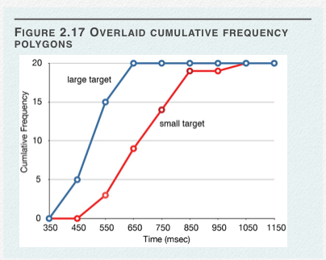
Overlaid Cumulative Frequency Polygons
Notes:
Source: Lane, Ch 2

Slide 61
Frequency Graphs
AKA histograms and frequency polygons
The goal is to get a sense of the shape of the data and how it is distributed
This will become important shortly

Slide 62
Box and Whisker Plots
The box is defined by:
25th percentile/quartile
Median (50th percentile/quartile)
75th percentile/quartile
The whiskers are usually:
The minimum and maximum
Excepting outliers

Slide 63
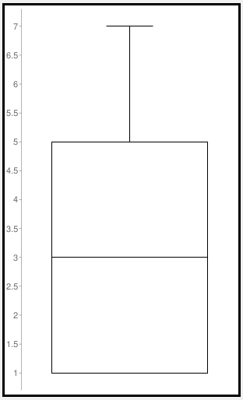
Box and Whisker Plot

Slide 64
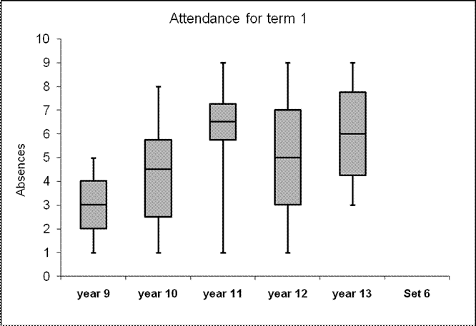
Box and Whisker Plot

Slide 65
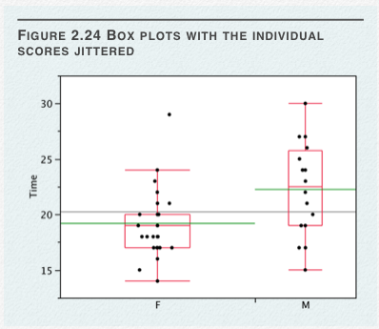
Many Variations
Notes:
Source: Lane, Ch 2

Slide 66
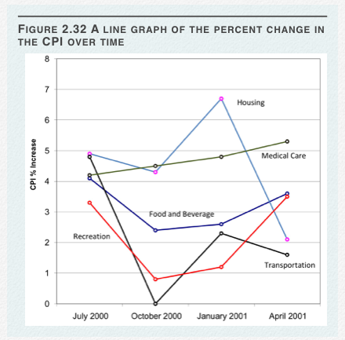
Line Graphs
Notes:
Source: Lane, Ch 2

Slide 67
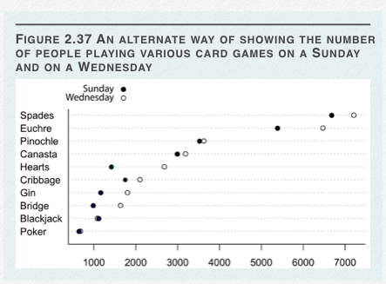
Dot Plots

Slide 68
Essential Questions
How should we decide what type of graph to use and what information to present?
What makes one graph better than another?

Slide 69
Next Time…
Descriptive Statistics
Describing data with numbers (statistics)
Central tendency
Spread

